Slide 1
ECE 551 Digital Design And Synthesis
Spring ‘19
For Loops & Synthesis
Generate Statements
Use of X in Synthesis
Synthesis Pitfalls
Coding for Synthesis

Slide 2
Administrative Matters
HW4 Moved to Friday Apr 5th@ class
Have you formed your project team and come up with a team name?
Video Lectures for Lecture8 are posted. There will be a quiz on Monday

Slide 3
For Loops & Synthesis
Can a For Loop be synthesized?
Yes, if it is fixed length
The loop is “unrolled”
reg [15:0] countmem [0:7];
integer x;
always @(posedge clk) begin
for (x = 0; x < 8; x = x + 1) begin
countmem[x] <= countmem[x] +1;
end
end
How do you think this code would synthesize?

Slide 4
For Loops & Synthesis
+1
+1
+1
…
16
16
16
clk
clk
clk
16
16
16
countmem[0]
countmem[1]
countmem[7]
These loops are unrolled when synthesized
That’s why they must be fixed in length!
Loop index is type integer but it is not actually synthesized
Example creates eight 16-bit incrementers.
What if loop upper limit was a parameter?

Slide 5
Unnecessary Calculations
Expressions that are fixed in a for loop are replicated due to “loop unrolling.”
Solution: Move fixed (unchanging) expressions outside of all loops.
for (x = 0; x < 8; x = x + 1) begin
for (y = 0; y < 8; y = y + 1) begin
index = x*8 + y;
value = (a + b)*c;
mem[index] = value;
end
end
This is just basic common sense, and applies to any language (in a programming language you would be wasting time, not hardware).
Yet this is a common mistake
Which expression(s) should be moved?

Slide 6
More on Loops & Synthesis
A loop is static (data-independent) if the number of iterations is fixed at compile-time
Loop Types
Static without internal timing control
Combinational logic
Static with internal timing control (i.e. @(posedge clk))
Sequential logic
Non-static without internal timing control
Not synthesizable
Non-static with internal timing control (i.e. @(posedge clk))
Sometimes synthesizable, Sequential logic

Slide 7
Static Loops w/o Internal Timing
Combinational logic results from “loop unrolling”
Example
always@(a) begin
andval[0] = 1;
for (i = 0; i < 4; i = i + 1)
andval[i + 1] = andval[i] & a[i];
end
What would this look like?
For registered outputs:
Change sensitivity list ‘a’ with ‘posedge clk’

Slide 8
Static Loops with Internal Timing
If a static loop contains an internal edge-sensitive event control expression, then activity distributed over multiple cycles of the clock
always begin
for (i = 0; i < 4; i = i + 1)
@(posedge clk) sum <= sum + i;
end
What does this loop do?
Does it synthesize?...Yes, but…

Slide 9
Non-Static Loops w/o Internal Timing
Number of iterations is variable
Not known at compile time
Can be simulated, but not synthesized!
Essentially an iterative combinational circuit of data dependent size!
always@(a, n) begin
andval[0] = 1;
for (i = 0; i < n; i = i +1)
andval[i + 1] = andval[i] & a[i];
end
What if n is a parameter?

Slide 10
Non-Static Loops with Internal Timing
Number of iterations determined by
Variable modified within the loop
Variable that can’t be determined at compile time
Due to internal timing control—
Distributed over multiple cycles
Number of cycles determined by variable above
Variable must still be bounded
always begin
continue = 1’b1;
while (continue) begin
@(posedge clk) sum = sum + in;
if (sum > 8’d42) continue = 1’b0;
end
end
Can this be synthesized?
What does it synthesize to?
Who really cares!
This is a stupid way to do it!
Use a SM.

Slide 11
Any loop with internal timing can be done as a SM
Previous example didn’t really even require a SM.
This code leaves no question how it would synthesize.
module sum_till (clk,rst_n,sum,in);
input clk,rst_n;
input [5:0] in;
output [5:0] sum;
always @(posedge clk or negedge rst_n)
if (~rst_n)
sum <= 6’h00;
else if (en_sum)
sum <= sum + in
assign en_sum = (sum<6’d43) ? 1’b1 : 1’b0;
endmodule
RULE OF THUMB:
If it takes you more than 15 seconds to conceptualize how a piece of code will synthesize, then it will probably confuse Synopsys too.

Slide 12
FSM Replacement for Loops
Not all loop structures supported by vendors
Can always implement a loop with internal timing using an FSM
Can make a “while” loop easily
Often use counters along with the FSM
All synthesizers support FSMs!
Synopsys supports for-loops with a static number of iterations
condition
condition
State3

Slide 13
Generated Instantiation
Generate statements ➔ control over the instantiation/creation of:
Modules
UDPs & gate primitives
continuous assignments
initial blocks & always blocks
Generate instantiations resolved during “elaboration” (compile time)
When module instantiations are linked to module definitions
Before the design is simulated or synthesized – this is NOT dynamically created hardware

Slide 14
Generate-Loop
A generate-loop permits making one or more instantiations (pre-synthesis) using a for-loop.
module gray2bin1 (bin, gray);
parameter SIZE = 8; // this module is parameterizable
output [SIZE-1:0] bin; input [SIZE-1:0] gray;
genvar i;
generate
for (i=0; i<SIZE; i=i+1) begin: bit
assign bin[i] = ^gray[SIZE-1:i]; \\ Data Flow replication
end
endgenerate
endmodule
Does not exist during simulation of design
Typically name the generate as reference

Slide 15
Generate Loop
Is really just a code replication method. So it can be used with any style of coding. Gets expanded prior to simulation.
module replication_struct(i0, i1, out);
parameter N=32;
input [N-1:0] i1,i0;
output [N-1:0] out;
genvar j;
generate
for (j=0; j<N; j=j+1)
begin : xor_loop
xor g1 (out[j],in0[j],in1[j]);
end
endgenerate
endmodule
Hierarchical reference to these instantiated gates will be:
…xor_loop[0].g1
…xor_loop[1].g1
.
.
.
…xor_loop[31].g1
Structural replication

Slide 16
Generate-Conditional
A generate-conditional allows conditional (pre-synthesis) instantiation using if-else-if constructs
module multiplier(a ,b ,product);
parameter a_width = 8, b_width = 8;
localparam product_width = a_width+b_width;
input [a_width-1:0] a; input [b_width-1:0] b;
output [product_width-1:0] product;
generate
if ((a_width < 8) || (b_width < 8))
CLA_multiplier #(a_width,b_width) u1(a, b, product);
else
WALLACE_multiplier #(a_width,b_width) u1(a, b, product);
endgenerate
endmodule
These are parameters, not variables!

Slide 17
Generate-Case
A generate-case allows conditional (pre-synthesis) instantiation using case constructs
See Standard 12.1.3 for more details
module adder (output co, sum, input a, b, ci);
parameter WIDTH = 8;
generate
case (WIDTH)
1: adder_1bit x1(co, sum, a, b, ci); // 1-bit adder implementation
2: adder_2bit x1(co, sum, a, b, ci); // 2-bit adder implementation
default: adder_cla #(WIDTH) x1(co, sum, a, b, ci);
endcase
endgenerate
endmodule
Of course case selector has to be deterministic at elaborate time, can not be a variable. Usually a parameter.

Slide 18
Synthesis of x and z
Only allowable uses of x is as “don’t care”, since x cannot actually exist in hardware
in casex
in defaults of conditionals such as :
The else clause of an if statement
The default selection of a case statement
Only allowable use of z:
Constructs implying a 3-state output
Of course it is helpful if your library supports this!

Slide 19
Don’t Cares
x, ?, or z within case item expression in casex
Does not actually output “don’t cares”!
Values for which input comparison to be ignored
Simplifies the case selection logic for the synthesis tool
casex (state)
3’b0??: out = 1’b1;
3’b10?: out = 1’b0;
3’b11?: out = 1’b1;
endcase
state[1:0]
00
01
11
10
state[2]
0
1 | 1 | 1 | 1
0 | 0 | 1 | 1
1
out = state[2] + state[1]

Slide 20
Use of Don’t Care in Outputs
Can really reduce area
case (state)
3’b001: out = 1’b1;
3’b100: out = 1’b0;
3’b110: out = 1’b1;
default: out = 1’b0;
endcase
state[1:0]
00
01
11
10
state[2]
0
0 | 1 | 0 | 0
0 | 0 | 0 | 1
1
case (state)
3’b001: out = 1’b1;
3’b100: out = 1’b0;
3’b110: out = 1’b1;
default: out = 1’bx;
endcase
state[1:0]
00
01
11
10
state[2]
0
x | 1 | x | x
0 | x | x | 1
1

Slide 21
Unintentional Latches
Avoid structural feedback in continuous assignments, combinational always
assign z = a | y;
a
z
y
assign y = b | z;
b
For conditional assignments, either:
Set default values before statement
Make sure LHS has value in every branch/condition
For warning, set hdlin_check_no_latch true before compiling

Slide 22
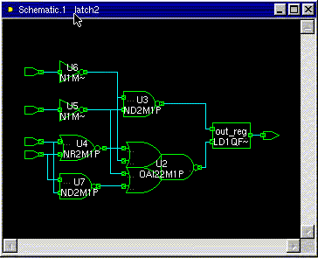
Synthesis Example [1]
module Hmmm(input a, b, c, d, output reg out);
always @(a, b, c, d) begin
if (a) out = c | d;
else if (b) out = c & d;
end
endmodule
a|b enables latch
How will this synthesize?
Area = 44.02
Either c|d or c&d are passed through an inverting mux depending on state of a / b

Slide 23
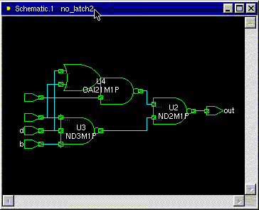
Synthesis Example [2]
module Better(input a, b, c, d, output reg out);
always @(a, b, c, d) begin
if (a) out = c | d;
else if (b) out = c & d;
else out = 1’b0;
end
endmodule
Perhaps what you meant was that if not a or b then out should be zero??
Area = 16.08
Does synthesize better…no latch!

Slide 24
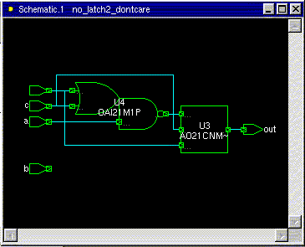
Synthesis Example [3]
module BetterYet(input a, b, c, d, output reg out);
always @(a, b, c, d) begin
if (a) out = c | d;
else if (b) out = c & d;
else out = 1’bx;
end
endmodule
Area = 12.99
But perhaps what you meant was if neiter a nor b then you really don’t care what out is.
Hey!, Why is b not used?

Slide 25
Gated Clocks
Use only if necessary (e.g., for low-power)
Becoming more necessary with demand for many low power products
This clock arrives later than the system clock it was derived from. We just created a min-delay problem. (race condition) (shoot through)
clk
clk_en
Min_delay_slack = clk2q – T_{Hold} – Skew_Between_clks

Slide 26
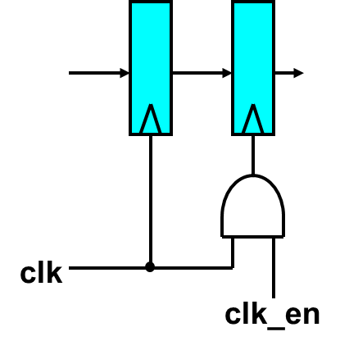
Gated Clocks (not so simple)
Something this simple does not work. Recall the enable function is probably coming from a SM. So it changes slightly after the rising edge of clock.
clk
clk_en
resulting gated clock
That’s pretty messed up!

Slide 27
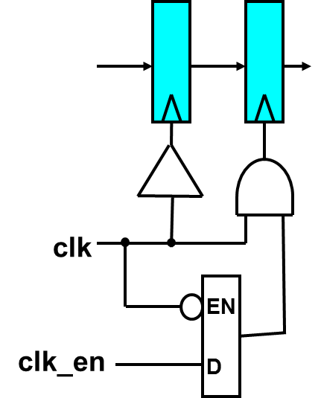
Gated Clocks (do it this way)
Have to use an enable low latch to latch the clock enable signal. This ensures the enable is setup and ready for the next high phase of clock
Have to balance from clock root to all leaf nodes of clock
clk
clk_en
resulting gated clock

Slide 28
Gated Clocks
Gated clock domains can’t be treated lightly:
1.) Skew between domains
2.) Loading of each domain. How much capacitance is on it? What is its rise/fall times
3,) RC in route. Is it routed in APR like any old signal, or does it have priority?
Clocks are not signals…don’t treat them as if they were.
1.) Use clock tree synthesis (CTS) within the APR tool to balance clock network (usually the job of a trained APR expert)
2.) Paranoid control freaks (like me) like to generate the gated domains in custom logic (like clock reset unit). Then let CTS do a balanced distribution in the APR tool.

Slide 29
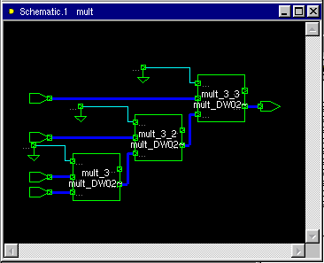
Chain Multiplier
module mult(output reg [31:0] out, input [31:0] a, b, c, d);
always@(*) begin
out = ((a * b) * c) * d;
end
endmodule
Area: 47381
Delay: 8.37

Slide 30
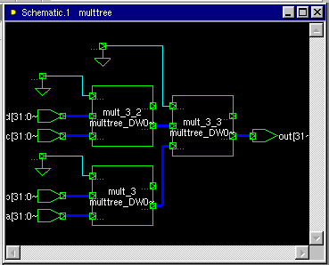
Tree Multiplier
module multtree(output reg [31:0] out, input [31:0] a, b, c, d);
always@(*) begin
out = (a * b) * (c * d);
end
endmodule
Area: 47590
Delay: 5.75 vs 8.37

Slide 31
Multi-Cycle Shared Multiplier
module multshare(output reg [31:0] out,
input [31:0] in, input clk, rst);
reg [1:0] cycle;
wire [31:0] multval;
always @(posedge clk)
if (rst) cycle <= 0;
else cycle <= cycle + 1;
always @(posedge clk)
out <= multval;
assign multval = (|cycle) ? out*in : in;
endmodule

Slide 32
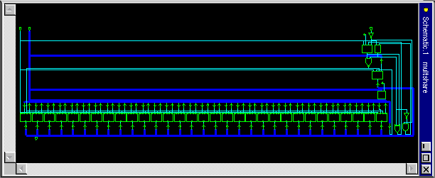
Multi-Cycle Shared Multiplier (results)
Area: 15990 vs 47500
Delay: 4*3.14
4 clocks, minimum period 3.14

Slide 33
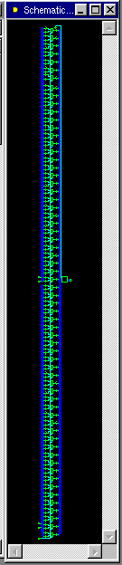
Shared Conditional Multiplier
module multcond1(output reg [31:0] out,
input [31:0] a, b, c, d, input sel);
always @(*) begin
if (sel) out = a * b;
else out = c * d;
end
endmodule
Mutually exclusive use of the multiply
Area: 15565
Delay: 3.14

Slide 34
Selected Conditional Multiplier [1]
module multcond2(output reg [31:0] out,
input [31:0] a, b, c, d, input sel);
wire [31:0] m1, m2;
assign m1 = a * b;
assign m2 = c * d;
always @(*) begin
if (sel) out = m1;
else out = m2;
end
endmodule

Slide 35
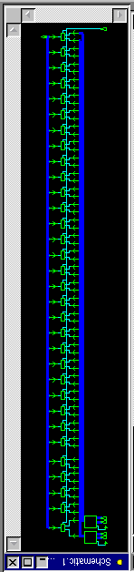
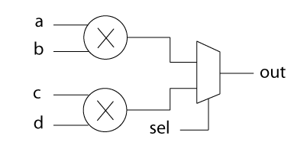
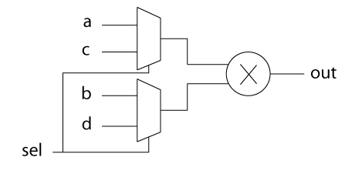
Selected Conditional Multiplier [2]
Area: 30764 vs. 15565
Delay: 3.02 vs. 3.14
Why is the area larger?

Slide 36
Conditional Multipler – One More Time
If you know ahead of time that you want two muxes and one multiplier, describe that directly!
Don’t rely on the synthesis tool to improve inefficient HDL; describe what you want first.
Caveat: You have to know what you want.
module multcond2(output reg [31:0] out,
input [31:0] a, b, c, d, input sel);
wire [31:0] op1, op2;
assign op1 = sel ? a : c;
assign op2 = sel ? b : d;
always @(*) begin
out = op1 * op2;
endmodule

Slide 37
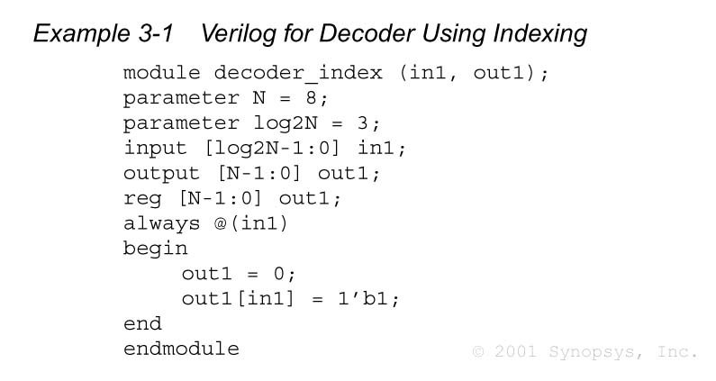
Decoder Using Indexing
What does synthesis do?
Think of Karnaugh Map

Slide 38
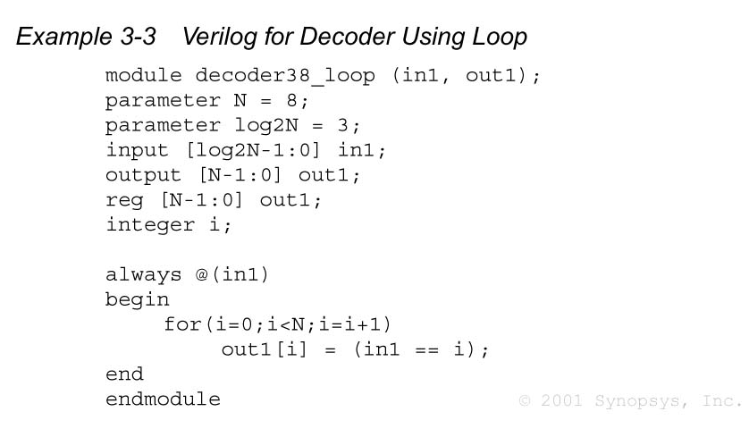
Decoder Using Loop
For this implementation how are we directing synthesis to think?
Assign each bit to digital comparator result

Slide 39
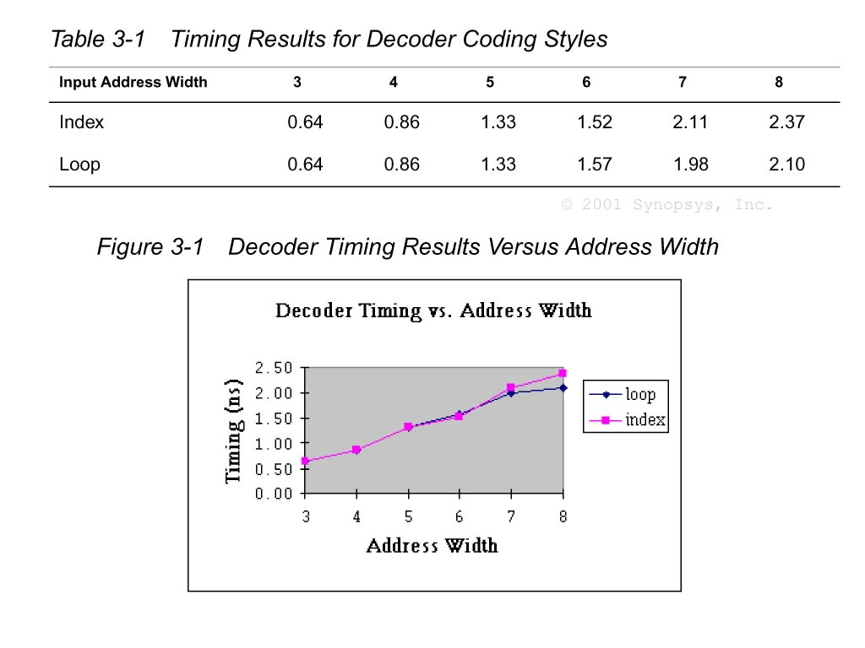
Decoder Verilog: Timing Comparison
Loop method
Starts to look advantageous

Slide 40
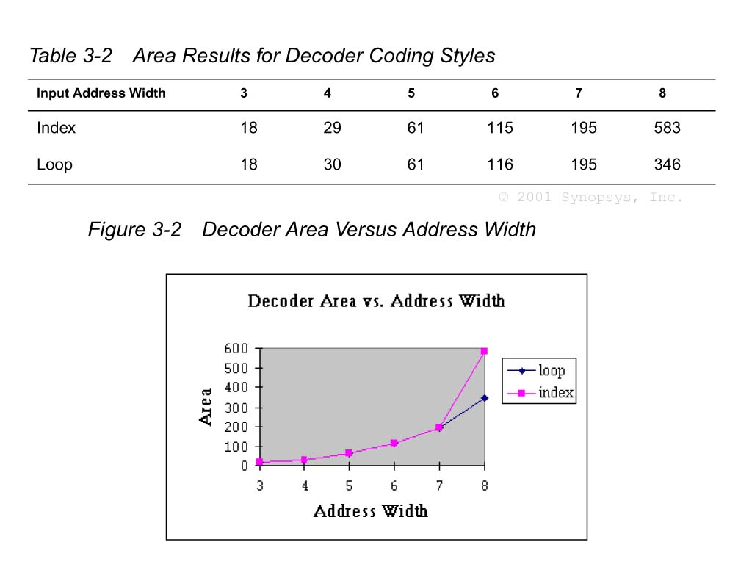
Decoder Verilog: Area Comparison
Loop method
Starts to look advantageous

Slide 41
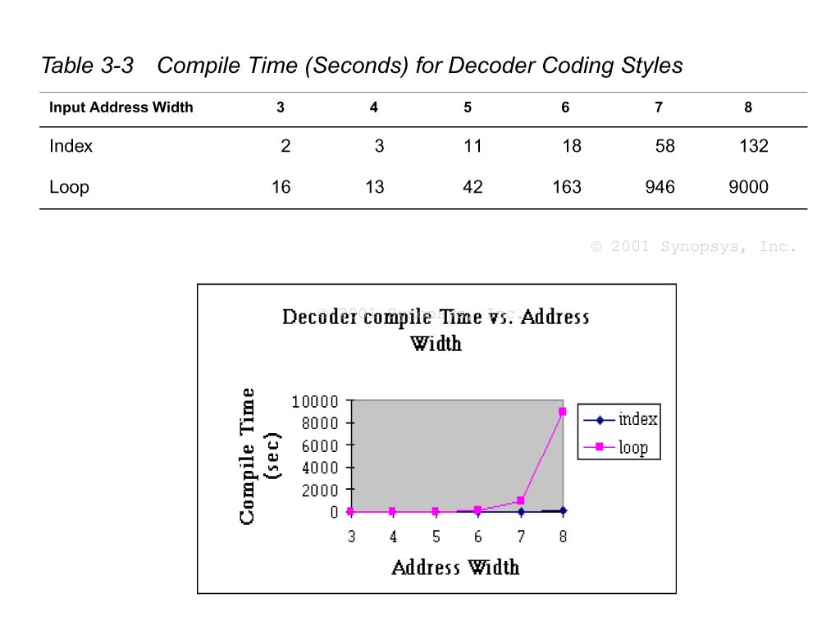
Decoder Verilog: Compile Time Comparison
Holy Mackerel Batman!
What is synthesis doing?
Why is it working so long and hard?
Looking for shared terms

Slide 42
Late-Arriving Signals
After synthesis, we will identify the critical path(s) that are limiting the overall circuit speed.
It is often that one signal to a datapath block is late arriving.
This signal causes the critical path…how to mitigate?:
Circuit reorganization
Rewrite the code to restructure the circuit in a way that minimizes the delay with respect to the late arriving signal
Logic duplication
This is the classic speed-area trade-off. By duplicating logic, we can move signal dependencies ahead in the logic chain.

Slide 43
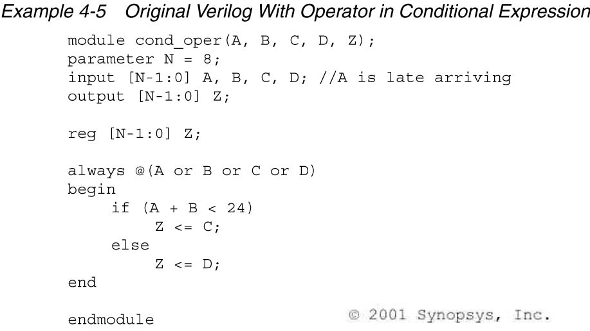
Logic Reorganization Example [1]

Slide 44
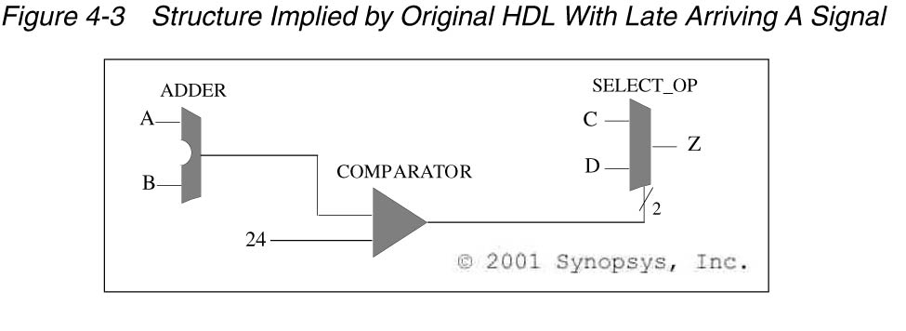
Logic Reorganization Example [2]
What can we do if A is the late-arriving signal?

Slide 45
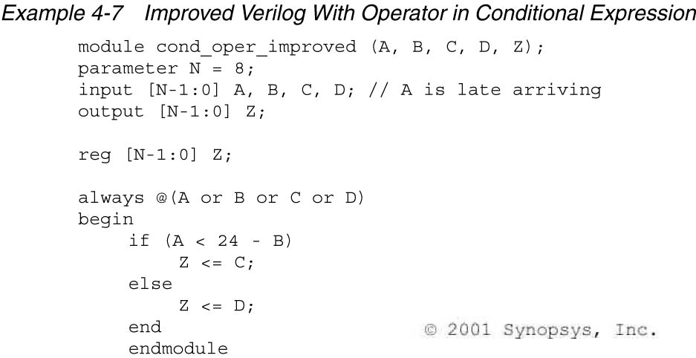
Logic Reorganization Example [3]
That’s right! We have to do the math, and re-arrange the equation so the comparison does not involve and arithmetic operation on the late arriving signal.

Slide 46
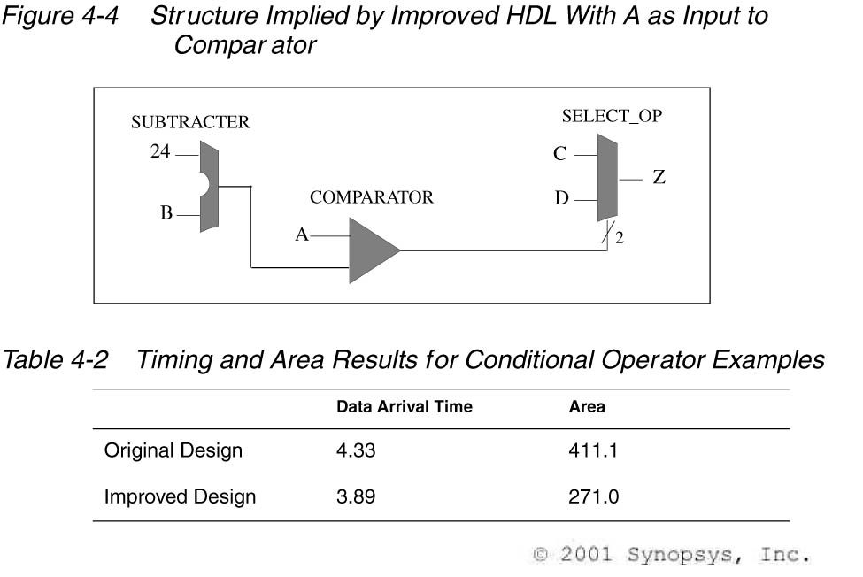
Logic Reorganization Example [4]
Why the area improvement?
Synopsys didn’t spend so much effort upsizing gates to try to make transisitons faster. This new design is faster, lower area, and lower power

Slide 47
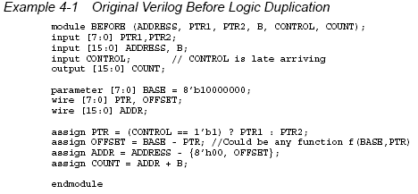
Logic Duplication Example [1]

Slide 48
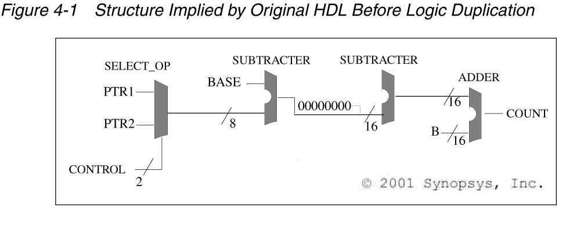
Logic Duplication Example [2]
What if control is the late arriving signal?

Slide 49
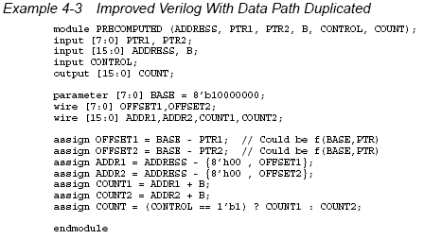
Logic Duplication Example [3]

Slide 50
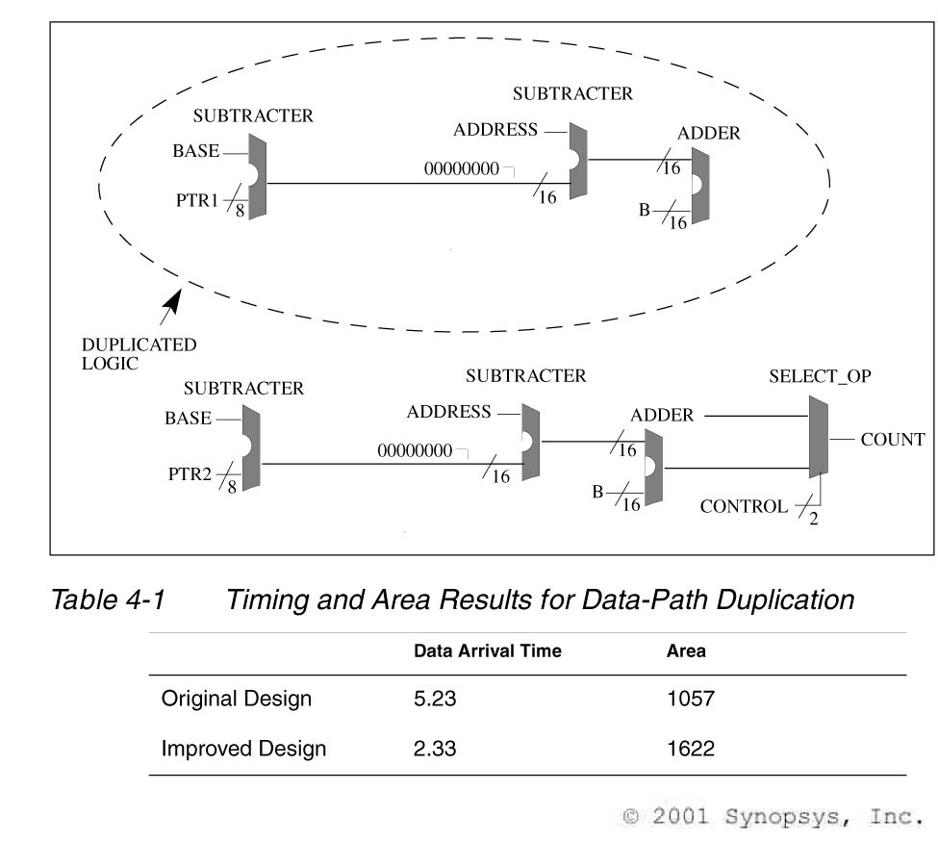
Logic Duplication Example [4]

Slide 51
Exercise
Assume we are implementing the below code, and cin is the late arriving signal? How can we optimize the resulting hardware for speed? At what cost?
reg [3:0] a, b;
reg [4:0] y;
reg cin;
y = a + b + cin;

Slide 52
Exercise
Revise to maximize performance wrt late
reg [3:0] state;
reg late, y, x1, x2, x3;
case(state)
SOME_STATE:
if (late) y = x1;
else y = x2;
default:
if (late) y = x1;
else y = x3;
endcase
Actually, there is nothing you can really do here. This is simple boolean logic, and synopsys already does a good job optimizing for late arriving.
Coding optimizations often apply more to larger functions (like arithmetic operations, & comparisons). Than to boolean logic.

Slide 53
Mixing Flip-Flop Styles (1)
What will this synthesize to?
module badFFstyle (output reg q2, input d, clk, rst_n);
reg q1;
always @(posedge clk)
if (!rst_n)
q1 <= 1'b0;
else begin
q1 <= d;
q2 <= q1;
end
endmodule
If !rst_n then q2 is not assigned…
It has to keep its prior value

Slide 54
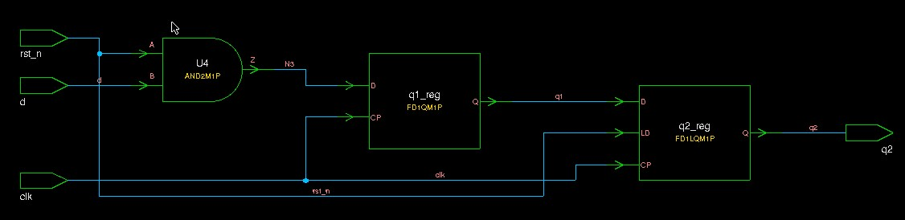
Flip-Flop Synthesis (1)
Area = 59.0
Note: q2 uses an enable flop (has mux built inside)
enabled off rst_n

Slide 55
Mixing Flip-Flop Styles (2)
module goodFFstyle (output reg q2, input d, clk, rst_n);
reg q1;
always @(posedge clk)
if (!rst_n) q1 <= 1'b0;
else q1 <= d;
always @(posedge clk)
q2 <= q1;
endmodule
Only combine like flops (same reset structure) in a single always block.
If their reset structure differs, split into separate always blocks as shown here.

Slide 56
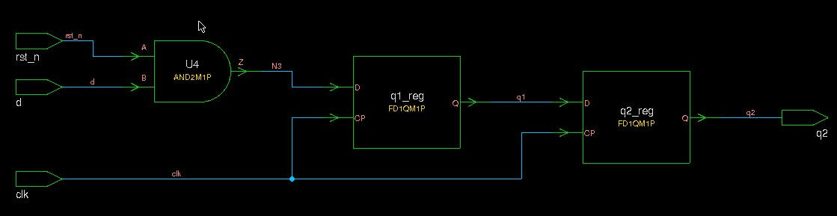
Flip-Flop Synthesis (2)
Area = 50.2 (85% of original area)
Note: q2 is now just a simple flop as intended

Slide 57
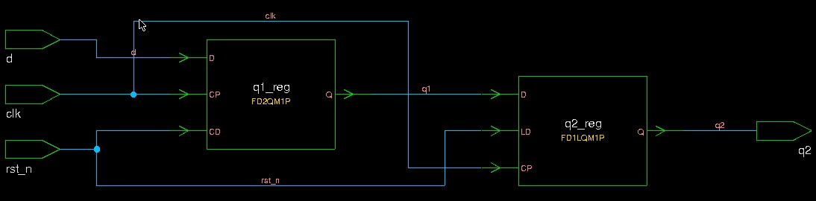
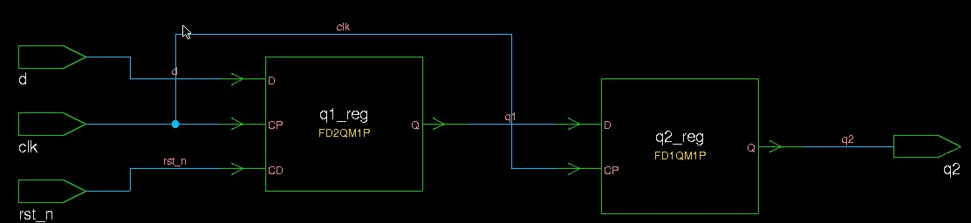
Flip-Flop Synthesis (3)
Note asynch area less than synch, and cell count less (less interconnect)
Using asynchronous reset instead
Bad (same always block): Area = 58.0
Good (separate always block): Area = 49.1

Slide 58
Conclusions
The designer is responsible for some optimizations that cannot be achieved by the synthesis tool.
It takes a lot of knowledge to be an expert designer
Hardware Design
HDL
Synthesis Tool
One of the largest roles of the designer is to understand tradeoffs and make appropriate decisions

